Slide 1

Course Overview

Slide 2
Deep Learning
It is now time to learn about one of the most fundamental libraries of using Python for Quantitative Analysis - NumPy!
NumPy is already included in the environment file provided, but just in case
conda install numpy

Slide 3
Machine Learning Overview

Slide 4
Machine Learning
Let’s discuss some basic machine learning concepts to set a foundation for future lectures!
We’ll talk about supervised learning, unsupervised learning, reinforcement learning, evaluation methods, and more.

Slide 5
Machine Learning
Unlike typical computer programs, machine learning techniques will iteratively learn from data.
ML algorithms can find insights in data, even if they aren’t specifically instructed what to look for in the data.

Slide 6
Machine Learning
In this course we’ll discuss three major types of machine learning algorithms
Supervised Learning
Unsupervised Learning
Reinforcement Learning
We’ll also touch on other topics, such as word embeddings with Word2Vec

Slide 7
Supervised Learning
Supervised Learning uses labeled data to predict a label given some features.
If the label is continuous its called a regression problem, if its categorical it is a classification problem.

Slide 8
Supervised Learning
Supervised Learning - Classification
Features: Height and Weights
Label: Gender
Task: Given a person’s height and weight, predict their gender.

Slide 9
Supervised Learning
Supervised Learning - Classification
Male
Height
Female
Weight

Slide 10
Supervised Learning
Supervised Learning - Classification
?
Male
Height
Female
Weight

Slide 11
Supervised Learning
Supervised Learning - Classification
Male
Height
Female
Weight

Slide 12
Supervised Learning
Supervised Learning - Regression
Features: Square Footage, Rooms
Label: House Price
Task: Given a house’s size and number of rooms, predict the selling price.

Slide 13
Supervised Learning
Supervised Learning - Regression
Price
Square Feet

Slide 14
Supervised Learning
Supervised Learning - Regression
Price
Square Feet

Slide 15
Supervised Learning
Supervised Learning - Regression
Price
Square Feet

Slide 16
Supervised Learning
Supervised Learning - Regression
Price
Square Feet

Slide 17
Supervised Learning
Supervised Learning has the model train on historical data that is already labeled (e.g. previous house sales).
Once the model is trained, it can then be used on new data, where only the features are known, to attempt prediction

Slide 18
Unsupervised Learning
But what if you don’t have historical labels for your data? (You only have features)
Since you have no “right answer” to fit on, you need to look for patterns in the data and find a structure.

Slide 19
Unsupervised Learning
Unsupervised Learning - Clustering
Features: Heights and Weights for breeds of dogs.
Label: No Label for unsupervised!
Task: Cluster together the data into similar groups. It is then up to the data scientist to interpret the clusters.

Slide 20
Supervised Learning
Unsupervised Learning - Clustering
Height
Weight

Slide 21
Supervised Learning
Unsupervised Learning - Clustering
Height
Weight

Slide 22
Supervised Learning
Unsupervised Learning - Clustering
Clustering won’t be able to tell you what the group labels should be.
Only that the points in each cluster are similar to each other based off the features.
Height
Weight

Slide 23
Reinforcement Learning
What about machine learning tasks like have a computer learn to play a video game, drive a car, etc… ?
Reinforcement learning works through trial and error which actions yield the greatest rewards.

Slide 24
Reinforcement Learning
Components
Agent-Learning/Decision Maker
Environment - What Agent interacts with
Actions - What the Agent can do

Slide 25
Reinforcement Learning
The agent chooses actions that maximize some specified reward metric over a given amount of time.
Learning the best policy with the environment and responding with the best actions.

Slide 26
Deep Learning
Let’s walk through the basic machine learning process for a supervised learning problem.
Afterwards we’ll discuss some key differences for unsupervised learning, as well discuss hold out data sets.

Slide 27
Acquire Data from Some Source
Data
Acquisition

Slide 28
Clean and Organize the Data
Data
Acquisition
Data
Cleaning

Slide 29
Train Test Split
Test
Data
Acquisition
Data
Cleaning
Train

Slide 30
Train/Fit Model on Training Data
Test
Data
Acquisition
Data
Cleaning
Train
Model
Train

Slide 31
Evaluate Model on Test Data
Test
Data
Acquisition
Data
Cleaning
Train
Model
Evaluate
Model
Train

Slide 32
Adjust Model Parameters
Test
Data
Acquisition
Data
Cleaning
Train
Model
Evaluate
Model
Train
Adjust Model Parameters

Slide 33
Deploy Model on New Incoming Data
Test
Data
Acquisition
Data
Cleaning
Train
Model
Evaluate
Model
Deploy
Model
Train
Adjust Model Parameters

Slide 34
Unsupervised Learning
Data
Acquisition
Data
Cleaning
Train
Model
Evaluate
Model
Deploy
Model
Train
Adjust Model Parameters

Slide 35
Hold Out Sets
Holdout
Test
Deploy
Data
Acquisition
Data
Cleaning
Train
Model
Test
Model
Evaluate
Model
Train
Adjust Model Parameters

Slide 36
Deep Learning
Finally let’s quickly discuss model evaluation, we’ll dive into more details for certain problems later on in the course.

Slide 37
Deep Learning
Supervised Learning -Classification Eval
Accuracy , Recall, Precision
Accuracy - Correctly Classified divided by total samples.
Which metric is the most important depends on the specific situation

Slide 38
Deep Learning
Supervised Learning -Regression Eval
MAE, MSE, RMSE
All are measurements of: On average, how far off are you from the correct continuous value.

Slide 39
Deep Learning
Unsupervised Learning - Evaluation
Much harder to evaluate, depends on overall goal of the task
Never had “Correct Labels” to compare to
Cluster Homogeneity, Rand Index

Slide 40
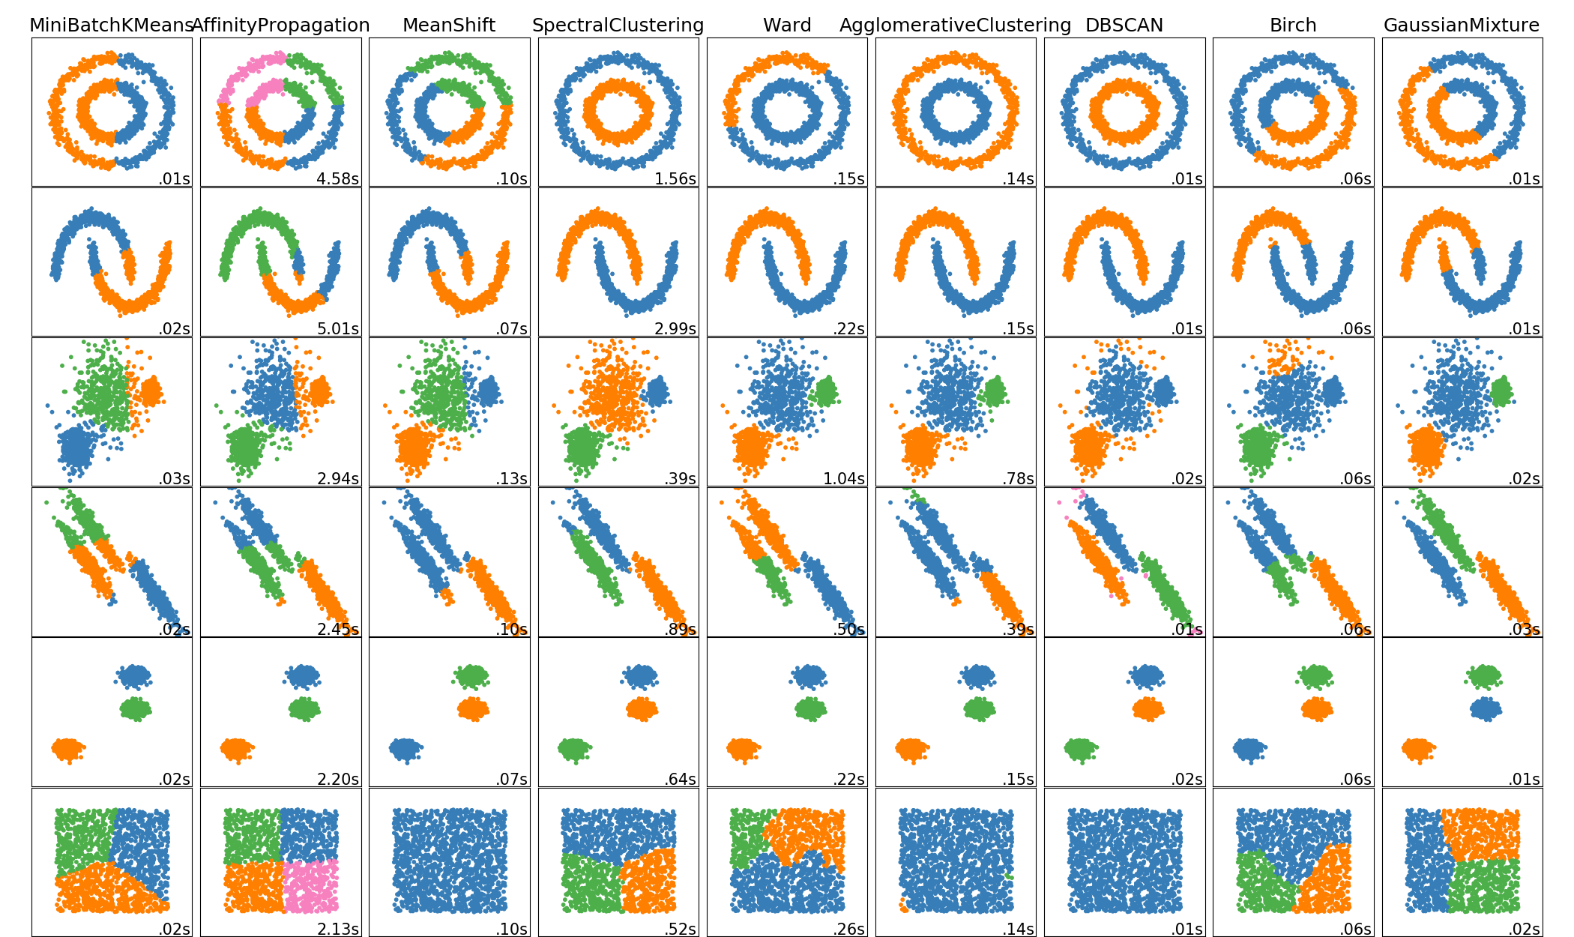
Deep Learning
Unsupervised Learning - Evaluation

Slide 41
Deep Learning
Reinforcement Learning - Evaluation
Usually more obvious, since the “evaluation” is built into the actual training of the model.
How well the model performs the task its assigned.

Slide 42
Deep Learning
Review
Machine Learning
Types of Machine Learning
Machine Learning Process
Evaluation Metrics

Slide 43
Crash Course Basics

Slide 44
Deep Learning
Very Basic Overview
NumPy
Pandas
Matplotlib and Pandas Data Viz
SciKit Learn Preprocessing

Slide 45
Deep Learning
Not meant to be a comprehensive overview!
Check out:
Python for Data Science and Machine Learning Bootcamp

Slide 46
NumPy Quick Overview

Slide 47
Pandas Quick Overview

Slide 48
Data Visualization
Quick Overview

Slide 49
SciKit-Learn
Quick Overview

Slide 50
Crash Course
Review Exercises

Slide 51
Crash Course
Exercise Solutions

